Slide 1











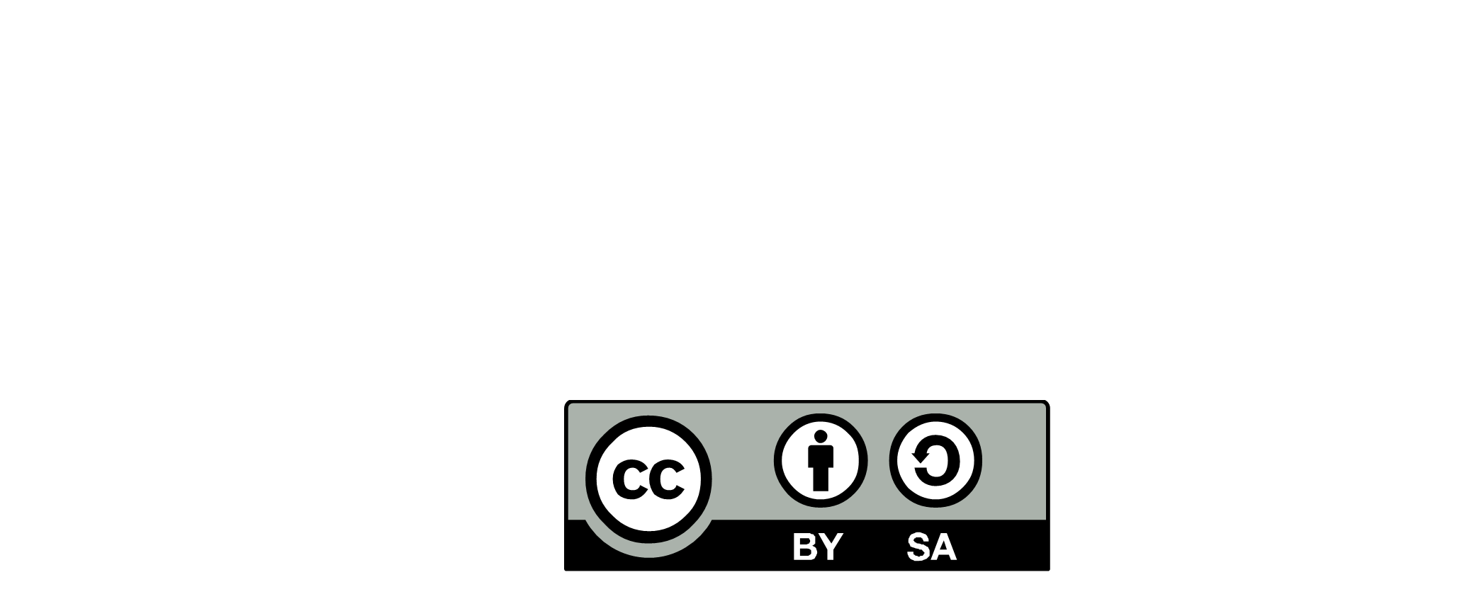

Design emerge from team, Architecture is a collaborative work
Data
expert
Tech.
expert
Communities
Of
Practices
Architecture
Community
EXPERTISE
Learn & mobilize
ACTIVE FELLOWSHIP
ASK FOR ADVANCED EXPERTISE
CONSOLIDATE EXP. REQUIREMENTS
LEAD PROBLEM SOLVING
CAPITALIZE
Security
expert
Infra.
expert
REFERENCE ARCHITECTURE
CONNECT THE DOTS
SYSTEM ENGINEERING
Innovate
QUALIFY ARCHITECTURE ISSUES
PROPOSE CHANGE
End-to-end Integration
MUTUAL REQUIREMENTS
TECHNICAL COMPLIANCE
PRODUCT/COMPONENT CATALOG
IS KNOWLEDGE
Co-develop architecture
capabilities
GREEN PATTERNS
PRINCIPLES
TECH RADAR
STANDARDS
BLUEPRINTS
IS
PORTFOLIO
FULL STACK
ARCHITECT
Rationalize
GLOBAL TECHNICAL DEBT
TECHNOLOGY ROADMAP
IS ROADMAP
IT PLATFORMS
Assembly & implement
STUDY AND SELECT
ASSEMBLING THE COMPONENTS
LOCAL IMPLEMENTATION
SERVICE LEVEL & NFRs
POPULATE REPOSITORIES
REDUCE TECHNICAL DEBT
Infras.
Service
lines
DIF
PLATFORM
SERVICES
TECH
SOLUTION
PROVIDERS
Domain
Program
PRODUCT EVOLUTION
Local Coaching
Mentoring
Continuous alignment
Business IT
END USER PROBLEM SOLVING
ARCHITECTURE RUNWAY
TECHNICAL DECISIONS
NON-FUNCTIONAL REQUIREMENTS
LOCAL TECHNICAL DEBT
REDUCE REFACTORING
INTEGRITY & CONSISTENCY
CONNECT THE DOT
SKILLS & COLLABORATION
FULL STACK DESIGN
Promote Reference Architecture
EXPLAIN
CONTEXTUALIZE
Be a change agent
TECH LEAD TEACHING & MENTORING
EVERGREEN AGENT
DECISION MAKER
DEVELOPPERS EMPOWERMENT
INNOVATION
Evolutionary design
TECHNICAL PRINCIPLES & PATTERNS
TECHNICAL CHOICES
FULL STACK VIEWS
TEAM
LEADER
UX
TEAM
LEADER
DELIVERY
SQUAD(s)
TEAM
LEADER
UX
DELIVERY
SQUAD(s)
DELIVERY
SQUAD(s)
TECH
LEAD
DEV.
TECH
LEAD
DEV.
TECH
LEAD
DEV.
Every Architecture issue is a learning opportunity
END USER*
- CLIENT
- BUSINESS
- EMPLOYEE
- PARTNER
UX
FULL STACK ARCHITECT
-2020.2 -
DESIGNED BY :

